Slide 1
HTML5 Techniques You Can Use Today
Or tomorrow because you are going to be super freaking busy today.

Slide 2


Your Host
Jim Cowart
Developer, Architect, OSS-author-wannabe
Chattanooga, TN
@ifandelse
JavaScript, C#, erlang
Once deleted an entire production sales pipeline database

Slide 3
Workshop Road Map
HTML5 Concepts
CSS3 Concepts
JavaScript Concepts
HTML5 Bleeding Edge Goodness
Notes:
Set the stage
Understand how the Web is evolving and how it affects you as web developers today
How many people consider themselves web developers?

Slide 4
You Should…
Learn a TON about HTML5
Leave With Confidence
Sound Smart In Conversations
Follow Me On Twitter @ifandelse
Ask Questions (if you have them)

Slide 5
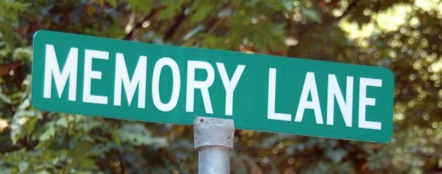
Notes:
What’s with the “5” in HTML5 anyways?
It’s good to know where we’ve come from…

Slide 6


Remember When?
Notes:
From Diving into HTML5: “While working on Internet Explorer 5 for Mac, the developers at Microsoft found themselves with a surprising problem. The upcoming version of their browser had improved its standards support so much, older pages no longer rendered properly. Or rather, they rendered properly (according to specifications), but people expected them to render improperly. The pages themselves had been authored based on the quirks of the dominant browsers of the day, primarily Netscape 4 and Internet Explorer 4. IE5/Mac was so advanced, it actually broke the web.”

Slide 7
<!DOCTYPE HTML
PUBLIC "-//W3C//DTD XHTML 1.0 Strict//EN”
"http://www.w3.org/TR/xhtml1/DTD/xhtml1-strict.dtd">
<!DOCTYPE HTML
PUBLIC "-//W3C//DTD HTML 4.01 Transitional//EN”
"http://www.w3.org/TR/html4/loose.dtd">
Notes:
From Diving into HTML5: Microsoft came up with a novel solution. Before rendering a page, IE5/Mac looked at the “doctype,” which is typically the first line of the HTML source (even before the <html> element). Older pages (that relied on the rendering quirks of older browsers) generally didn’t have a doctype at all. IE5/Mac rendered these pages like older browsers did. In order to “activate” the new standards support, web page authors had to opt in, by supplying the right doctype before the <html> element. This idea spread like wildfire, and soon all major browsers had two modes: “quirks mode” and “standards mode.” Of course, this being the web, things quickly got out of hand. When Mozilla tried to ship version 1.1 of their browser, they discovered that there were pages being rendered in “standards mode” that were actually relying on one specific quirk. Mozilla had just fixed its rendering engine to eliminate this quirk, and thousands of pages broke all at once. Thus was created — and I am not making this up — “almost standards mode.”

Slide 8

Standards Mode
Quirks Mode
Almost Standards Mode
"The last time I tried to count, there were 5 doctypes that triggered “almost standards mode,” and 73 that triggered “quirks mode” … & I’m not even going to talk about the crazy things that Internet Explorer 8 does to switch between its four — four! — different rendering modes…. Kill it. Kill it with fire."
Notes:
There are 15 doctypes that trigger standards mode…

Slide 9


Notes:
Needless to say, where we’ve BEEN isn’t good enough. HTML needed to evolve

Slide 10
“
While it continues to serve as a rough guide to many of the core features of HTML, it does not provide enough information to build implementations that interoperate with each other and, more importantly, with a critical mass of deployed content. ”
-W3C on HTML4
Notes:
http://dev.w3.org/html5/html4-differences/
Goes on to say:
The same goes for XHTML1, which defines an XML serialization for HTML4, and DOM Level 2 HTML, which defines JavaScript APIs for both HTML and XHTML. HTML5 will replace these documents.

Slide 11
HTML4 = Rough Guide
Unpredictable Browser Support
Notes:
HTML4 = Rough Guide for HTML
Because HTML4 was a rough guide, browsers had “wiggle room” to interpret them, which lead to unpredictable browser support.
Same has been true for JS and especially CSS

Slide 12

HTML5:
<!DOCTYPE html>
Notes:
The doctype is one TEENY TINY sliver of changes in HTML5, but the simplification is indicative of what the W3C is trying to do….

Slide 13
How is the web evolving? (It’s SO much cooler than doctypes!)

Slide 14
{
}
<HTML>
CSS:3;
EMCAScript();
“HTML5”

Slide 15

Canvas
Semantic Tags
SVG
Video
Geolocation
“Living Standard”
Offline
Canvas
Video
Audio
WebSockets FileAPI
WebGL
HTML5 Forms
Geolocation
WHATWG | W3C | IETF
Notes:
WHATWG FAQs on Living Standard: http://wiki.whatwg.org/wiki/FAQ#What_does_.22Living_Standard.22_mean.3F
Lots of standards which are currently being evolved
HTML5 doesn’t really need the 5 anymore, it’s just HTML evolving iteratively in the future
Certain things get more refined than others
Browser creators create a relatively similar approach
Trying to target anyone anywhere

Slide 16

Stable
Canvas | Local Storage | Microdata | Document Editing | Geolocation | Semantic Tags | Video/Audio | Selectors
In Progress
WebGL | WebSockets | File API | Drag-Drop API | IndexDB | Offline API | Web Workers | HTML5 Forms
Notes:
Not a formal grouping, something that was assembled for the presentation today
Some of these go back to earlier versions of browsers
Not going to focus too much on “In Progress” items since we want to see what we can do today

Slide 17
Notes:
What is the IE strategy for HTML5/CSS3?

Slide 18
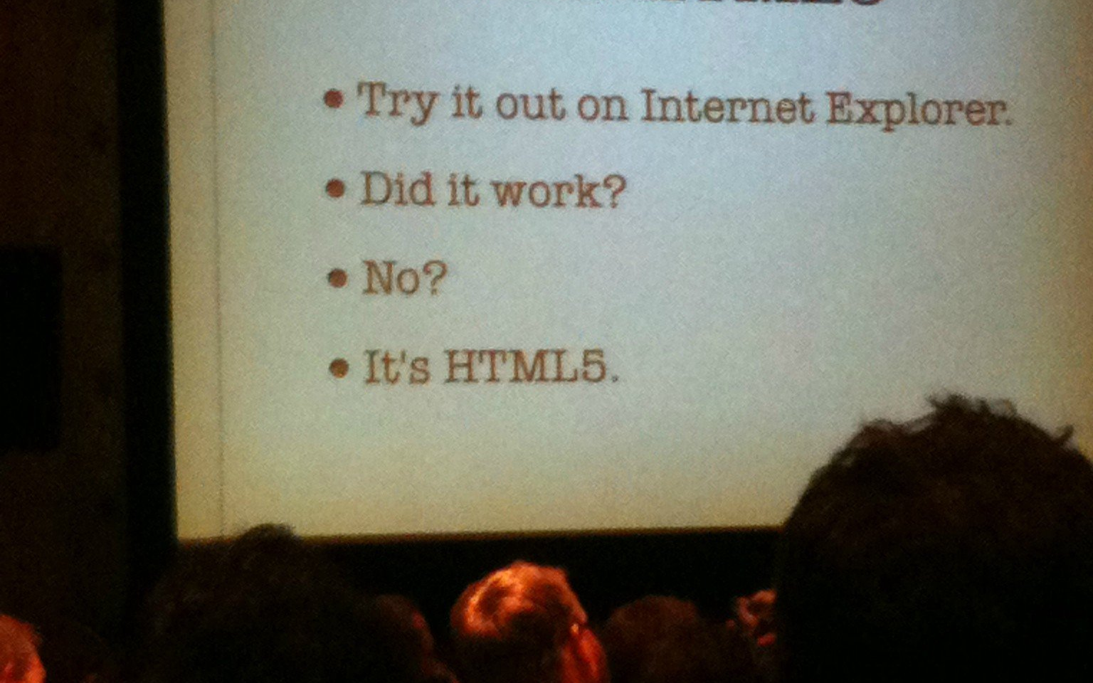
How To Spot HTML5
The IE Test
Notes:
I know I know – not terribly fair anymore, per se. But until 10 and 11 are the legacy/mainstream installs, this kinda works ☺

Slide 19
IE9 offers support for the most relevant, real-world web patterns that developers are using today as well as the HTML5 patterns we expect to become more mainstream.”
“
-Dean Hachamovitch
Corporate VP, IE
Notes:
On Microsoft’s strategy/approach to HTML5:
http://blogs.msdn.com/b/ie/archive/2010/12/20/html5-site-ready-and-experimental.aspx
http://blogs.msdn.com/b/interoperability/archive/2010/12/21/prototyping-early-w3c-html5-specifications.aspx
- Stable category items go into IE9

Slide 20
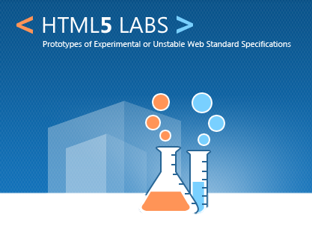
html5labs.interoperabilitybridges.com
+
Platform Previews
ie.microsoft.com/testdrive
Notes:
http://html5labs.interoperabilitybridges.com/
http://www.beautyoftheweb.com
- MS not turning their back to other standards, HTML5 Labs used for the more “in progress” items.

Slide 21
CSS 2.1
Selectors
CSS Color
WD
LC
CR
PR
REC
CSS 2
25+ Drafts
Transitions
Transformations
Animations
Gradients
CSS3 Text
Backgrounds &
Borders
Media Queries
Multi-column
Notes:
CSS3’s evolutionary approach
Microsoft is focusing primarily on adding product support at the Candidate Recommendation stage
Review status of various CSS3 proposed specs: http://www.w3.org/Style/CSS/current-work
WD = working draft
LC = last call
Candidate Recommendation
Proposed Recommendation
Recommendation
Rec = most power that a standard has
CSS2.1 is what we all use today, not even rec

Slide 22
-moz-border-radius: 5px 5px 5px 5px;
-webkit-border-radius: 5px;
border-radius: 5px;
-moz-box-shadow: 2px 2px 2px #333;
-webkit-box-shadow: 2px 2px 2px #333;
box-shadow: 2px 2px 2px #333;
-webkit-background-size: 137px 50px;
-o-background-size: 137px 50px;
background-size: 137px 50px;
Notes:
Want to implement something early? Don’t use a name which can become a standard
IE vs Netscape
Future-proofing by providing the standard last. Browsers will stop at the last one it recognizes

Slide 23
Browser Prefixes
-webkit
-moz
-o
-ms
“standard” way browsers implement experimental features
Notes:
Chrome is not going to use prefixes going forward in Blink…..

Slide 24
WD
LC
CR
PR
RE
Notes:
- MS’ approach is to implement items on CR and on

Slide 25
What is usable today?
Notes:
This is not a question with a single correct answer. It all depends on your audience and strategy.
There are several general strategies for defining what is “usable” today.

Slide 26
Adoption Strategies
X | X | X | X | X
X |  |  | X | X
 | X |  |  | X
 | X | X | X
 |  | X |  | X
Lowest Common Dominator
Only use features natively available in all target browsers
Notes:
- Broad deployment of old browsers = usage of old HTML

Slide 27
Adoption Strategies
X | X | X | X | X
X |  |  | X | X
 | X |  |  | X
 | X | X | X
 |  | X |  | X
Polyfill Enriched
Only use features either natively available OR available via JavaScript polyfill
X X

Slide 28
polyfill
(n) poly • fill: JavaScript that implants HTML5 functionality in a browser that does not offer native support
Notes:
Useful for adding HTML5 to both older browsers + new browsers that do not have a specific HTML5 feature

Slide 29
Adoption Strategies
X | X | X | X | X
X |  |  | X | X
 | X |  |  | X
 | X | X | X
 |  | X |  | X
Alternate Experiences
Only use features available in target browsers AND design alternate experience for other browsers
X X
X X X
X X

Slide 30
progressive enhancement graceful degradation
Notes:
Should learn these two terms
Two sides of a coin

Slide 31


[Source: Aaron Olaf, Flickr]
Notes:
Progressive enhancement
Cheese pizza is what we are used to and love with pizzas
Second pizza is an enhanced pizza, it has been progressively enhanced
Design for a great core common denominator experience (cheese pizza)
Enrich as resources are available.

Slide 32
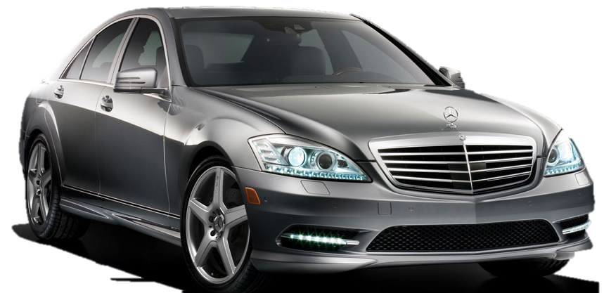
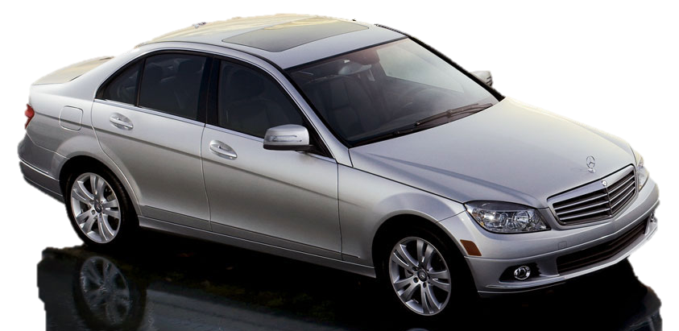
[Source: Mercedes USA, http://mbusa.com/]
Notes:
Graceful Degregation
Strategy: Design for best case scenario (premium features), and gracefully remove features as resources are not available

Slide 33
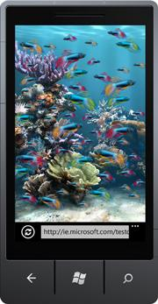
Adoption Strategies
X | X | X | X | X
X |  |  | X | X
 | X |  |  | X
 | X | X | X
 |  | X |  | X
Vertical Target
Create experiences targeted at specific browsers (or classes of browsers)
X X
X X X
X X
Notes:
Not recommended for desktop browsers, but OK for mobile devices.
Not a broad deployment of legacy browsers – also people tend to update phones more often

Slide 34
HTML Techniques
You can use today

Slide 35
Enriching VS Experience
Add IntelliSense & Schema Validation to
Visual Studio 2008/2010 (pre SP1) editor
http://bit.ly/vsHTML5
http://bit.ly/vsSVG
Notes:
HTML5 & CSS3 in VS2010 SP1: http://madskristensen.net/post/HTML5-CSS3-in-Visual-Studio-2010-SP1.aspx
HTML5 in VS2008: http://stackoverflow.com/questions/1682180/will-visual-studio-2010-support-html-5

Slide 36
Older Browsers
Shim it
Transparent to users
Parity
Kill it
Full stop, force upgrade
Target it
Down-level experience
Notes:
http://code.google.com/p/ie7-js/
Testing IE: http://spoon.net/browsers/
Three choices:
Hack it – Force features with JS shims
Support it – Provide gracefully degraded experience
Kill it – Provide message indicating no or limited support

Slide 37
Modernizr
Simple way to check feature support
Conditional JS and CSS
.multiplebgs div p {
/* properties for browsers that
support multiple backgrounds */
}
.no-multiplebgs div p {
/* optional fallback properties
for browsers that don't */
}
if (Modernizr.canvas) {
//Canvas supported
}
if (Modernizer.cssColumns){
//Columns supported
}
//Etc...
*Don’t use with IE HTML5shiv. One or the other.
Notes:
- Check if feature is available – not which browser you are using
http://www.modernizr.com
http://www.alistapart.com/articles/taking-advantage-of-html5-and-css3-with-modernizr/
Modernizr now ships with ASP.NET MVC 3

Slide 38
Polyfilling & Older Browsers
with Modernizr
Notes:
MIGHT pull this slide out

Slide 39
Semantic Tags
Tags with meaning
<body>
<div id=“header”>
</div>
<div id=“content”>
<div id=“nav”></div>
</div>
<div id=“footer”>
</div>
</body>
<body>
<header>
</header>
<section>
<nav></nav>
</section>
<footer></footer>
</body>
VS.
*Need polyfill to trigger styling in old IE
Safe to use today!
Notes:
Accessible Screen Readers and SEO Robots are not allowed to extract information from attributes (id is a tag)
Thus, semantic tags
HTML5 = backwards compatible
Don’t delete DOCTYPE = without DOCTYPE we are running in “quirks” mode

Slide 40
Video & Audio
Semantic rich media
Reach more people on more devices
Silverlight
Flash
HTML5
Container
Codec
MP4
H.264
Safe to use today!
Notes:
Container = file extensions
Codec = the impression technique
Rather than have multiple encoding, use the one that’s supported across all platforms.

Slide 41
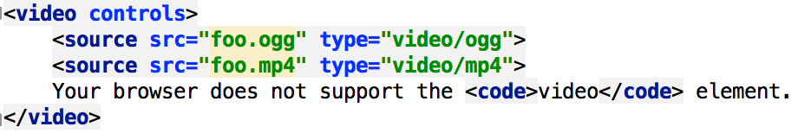
Video
Safe to use today!
Notes:
Container = file extensions
Codec = the impression technique
Rather than have multiple encoding, use the one that’s supported across all platforms.

Slide 42
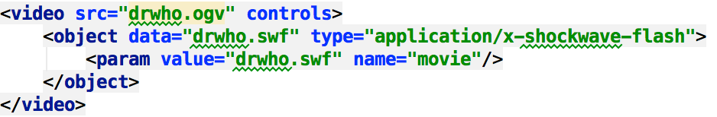
Video – w/fallback option
Safe to use today!
Notes:
Container = file extensions
Codec = the impression technique
Rather than have multiple encoding, use the one that’s supported across all platforms.

Slide 43
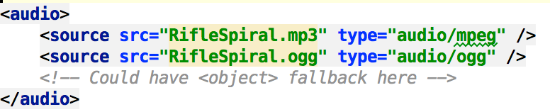
Audio
Safe to use today!
Notes:
Container = file extensions
Codec = the impression technique
Rather than have multiple encoding, use the one that’s supported across all platforms.

Slide 44
Geolocation
Usable on modern browsers + mobile
Requires plug-in for older browsers
navigator.geolocation.getCurrentPosition(callback);
function callback(position){
var lat = position.coords.latitude;
var lng = position.coords.longitude;
var acc = position.coords.accuracy;
}
Safe to use today!
Notes:
Opt-in
Simple way to call
Does not exist in older browsers
Use this for modern browsers, otherwise use IP address

Slide 45
Local Storage
Usable in modern browsers
sessionStorage = per window
localStorage = per browser
sessionStorage.setItem('value', this.value);
localStorage.setItem('value', this.value);
sessionStorage.getItem(‘value’);
sessionStorage.clear();
localStorage.clear();
5 MB limit (usually)
Notes:
Cookies on steroids
What is an issue with cookies? (sending back and forth)
LS = stored client-side up to 5 MB
To use universally you have to use JavaScript Polyfill – amplify.js (gives API to do LS across all browsers) or store.js

Slide 46
HTML5 Forms
Improved usability
Uneven support across browsers
<form name="f">
<input id="q" autofocus>
<!--Technique to support older browsers-->
<script>
if (!("autofocus" in document.createElement("input"))) {
document.getElementById("q").focus();
}
</script>
<input type="submit" value="Go">
</form>
Safe to use today!

Slide 47
HTML5 Forms
placeholders
<form>
<input name="q" placeholder=”Enter a search term">
<input type="submit" value="Search">
</form>
Safe to use today!

Slide 48
HTML5 Forms
13 New Input Types!
color
date
email
number
range
tel
url
and more!
Safe to use today!
Notes:
Nice thing is that older browsers will simply render them as text boxes, for example. They’ll still work.
You get a great breakdown of form behaviors/attributes on mdn: https://developer.mozilla.org/en-US/docs/Web/HTML/Element/Input

Slide 49
Other New Elements
<article>
<address>
<aside>
<main>
<math>
<figure>
<time>
<canvas>
<svg>
and others…
Notes:
Article - self-contained content that could exist independently of the rest of the content.
Address – Defines a section containing contact information.
Aside - content loosely related to the page content. If it is removed, the remaining content still makes sense.
Main - Defines the main or important content in the document. There is only one <main> element in the document.
Math - Defines a mathematical formula.
Figure - Represents a figure illustrated as part of the document.
Time - Represents a date and time value; the machine-readable equivalent can be represented in the datetime attribute.
Canvas – Represents a bitmap area that scripts can be used to render graphics, like graphs, game graphics, or any visual images on the fly.
Svg – Defines an embedded vectorial image .

Slide 50
SVG & Canvas
Scalable Vector Graphics
Vector-output
Good for interaction
Canvas
Bitmap-output
Good for animation
JavaScript-based
XML-based
Safe to use today!
Notes:
http://upload.wikimedia.org/wikipedia/en/d/d0/Chrome_Logo.svg
Comparison articles:
Great comparison: http://dev.opera.com/articles/view/svg-or-canvas-choosing-between-the-two/
http://blogs.sitepoint.com/2010/07/06/canvas-vs-svg-how-to-choose/ (IDEA: progressive enhancement techniques — for example, IE8 and earlier versions show a table of data whereas supported browsers show an animated pie chart.)
SVG Bridge for all browsers: http://raphaeljs.com/
CANVAS Bridge for IE: http://code.google.com/p/explorercanvas/
(Pointless canvas example: http://paulirish.com/2010/high-res-browser-icons/)
SVG is DOM-based. All elements exist in DOM. Thus, you can attach event handlers. CON: Many objects can hurt perf.
CANVAS is PIXEL-based. All elements rendered quickly, but not part of DOM. CON: Harder to interact.

Slide 51
Canvas for IE6/7/8
Many polyfills for older browsers (besides IE)
JavaScript or Flash based
ExCanvas
FlashCanvas
Better Perf
Notes:
http://flashcanvas.net/
http://code.google.com/p/explorercanvas/
Practical use case
http://szimek.github.io/signature_pad/
Lots of fun ideas
http://paperjs.org/showcase/

Slide 52
CSS3 Techniques
You can use today..
Notes:
We’re going to go into MORE detail on this in the CSS presentation……

Slide 53
CSS3 Selectors
Powerful new selector options
//Alternating Items
li:nth-child(odd) { color: blue; }
li:nth-child(even) { color: green; }
li:nth-child(3n) { color: red; } //Every 3rd item
//First/Last Items
li:first-of-type { color: blue; }
li:not(:first-of-type):not(:last-of-type) { color: orange; } //All *but* first/last
//Enabled/Disabled
input:enabled { border: 2px solid green; }
input:disabled { background-color: #BBB; }
*Use jQuery to support legacy browsers
Notes:
jQuery supports CSS3 Selectors
Alternating items to be different (odd, even, 3n above)

Slide 54
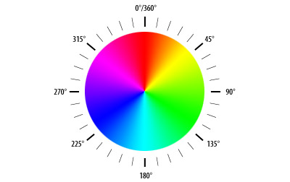
CSS3 Color
HSL and RGB
Support for new color models + alpha channels
//RGB
background:rgb(155,100,100);
//RGBa
background:rgba(153, 134, 117, 0.2);
//HSL
background:hsl(320,100%,25%);
//HSLa
background:hsla(165, 100%, 50%, 1.0);

Slide 55
Custom Fonts
Biggest Problem?
Licensing!
@font-face {
font-family: Delicious;
src: url('Delicious-Roman.otf') format(“opentype”);
}
//Usage
h3 { font-family: Delicious, sans-serif; }
Notes:
@font-face was first proposed for CSS2 and has been implemented in Internet Explorer since version 5
IE relied on proprietary Embedded Open Type (.eot)
Old school solutions involved things like sIFR (http://www.mikeindustries.com/blog/sifr/)
Modern browsers finally support TTF and OTF + Most support new WOFF (exception is Safari)
Resources:
http://www.css3.info/preview/web-fonts-with-font-face/
http://www.alistapart.com/articles/cssatten

Slide 56
Web Font Providers
Solve the licensing problem
Host the WOFF/TTF/OTF font files
Provide easy-to-use code
http://www.fontsquirrel.com/
http://webfonts.fonts.com
http://typekit.com/libraries
http://code.google.com/webfonts
Notes:
Problem has never been the technology
Problem was always licensing. Fonts are licensed in unique ways for use on desktops. No license for anyone downloading them (happens when on website)
Naturally font makers want to get paid for their work! Freemium and Premium services serving fonts have sprung up. FontSquirrel, Google Fonts, typekit, etc.

Slide 57
Borders & Backgrounds
Rounded corners, drop shadows, multi-backgrounds
Expect GD for older browsers
//Rounded Corners (Size)
border-radius: 5px;
//Drop shadow (hShift vShift Size Color)
box-shadow: 2px 2px 5px #333;
//Background control
background: url(top.gif) top left no-repeat,url(bottom.gif) bottom left no-repeat;
background-size: 150px 50px;
*Use CSS3 PIE to support legacy IE browsers
Notes:
Fix “bleeding” in Webkit with: -webkit-background-clip: padding-box;
http://tumble.sneak.co.nz/post/928998513/fixing-the-background-bleed
http://css3pie.com/ - polyfill

Slide 58
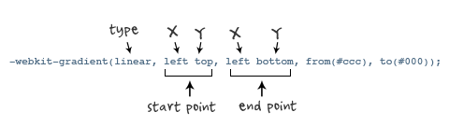
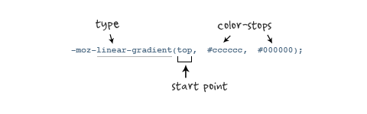
Gradients
Emerging CSS standard
But useful and desirable
Can be “shimmed” to support all browsers
Notes:
Relatively new CSS standard defining Gradients: http://www.w3.org/TR/css3-images/
IMAGES FROM: http://www.webdesignerwall.com/tutorials/cross-browser-css-gradient/
Great visual CSS gradient generator: http://www.display-inline.fr/projects/css-gradient/#startType=hex&startValue=aaeeff&endType=hex&endValue=3399cc
Simple Visual gradient creator: http://gradients.glrzad.com/
Good explanation:
http://www.dynamicdrive.com/style/csslibrary/item/css3_linear_gradients/
background: black;
background: -moz-linear-gradient(top, black, white);
background: -webkit-gradient(linear, 0% 0%, 0% 100%, from(black), to(white));
/*You can also make gradient stops*/
-moz-linear-gradient(
top,
rgb(214,24,166) 0%,
rgb(255,51,200) 50%,
rgb(255,77,240) 87%
)

Slide 59
Media Queries
Target styles to specific devices…
And features!
/*These two rules do the same thing*/
@media all and (min-width:500px) { … }
@media (min-width:500px) { … }
/*Multiple conditions*/
@media screen and (min-width: 600px) and (max-width: 900px) {
.class {
background: #333;
}
}
Notes:
http://www.webdesignerwall.com/tutorials/css3-media-queries/
http://www.w3.org/TR/css3-mediaqueries/
http://www.w3.org/TR/2010/CR-css3-mediaqueries-20100727/

Slide 60
Tomorrow Land (aka Mobile)
 | iOS | Android | Windows Phone (ie10)
Geolocation | ☑ | ☑ | ☑
 |  | ☑ | ☑
Offline | ☑ | ☑ | ☑
Local Storage | ☑ | ☑ | ☑
Video/Audio | ☑ | ☑ | ☑
Canvas | ☑ |  | ☑
SVG | ☑ | ☑ | ☑
Gradients* | ☑ | ☑ | ☑
CSS3 Animations* | ☑ | ☑ | ☑
Text Shadows | ☑ | ☑ | ☑
CSS3 Transforms | ☑ | ☑ | ☑

Slide 61
resources
HTML5 Doctor – A great resource for learning HTML5. http://bit.lypLzbFf
HTML 5 Cheat Sheet – A great quick guide to HTML 5 as a printable PDF. bit.ly/o1CIDE
HTML5 Demos – A great selection of HTML5 Demos. bit.ly/pwWCoJ
HTML5 Rocks – Various samples and demo code. bit.ly/obtwLz

Slide 62
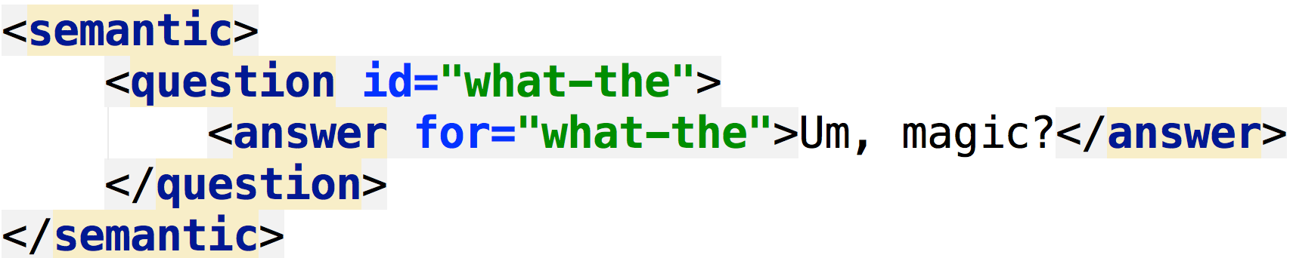
Questions?

